Slide 1
Philippine bus number location identification
By Jedidiah Caychingco

Slide 2
introduction

Slide 3
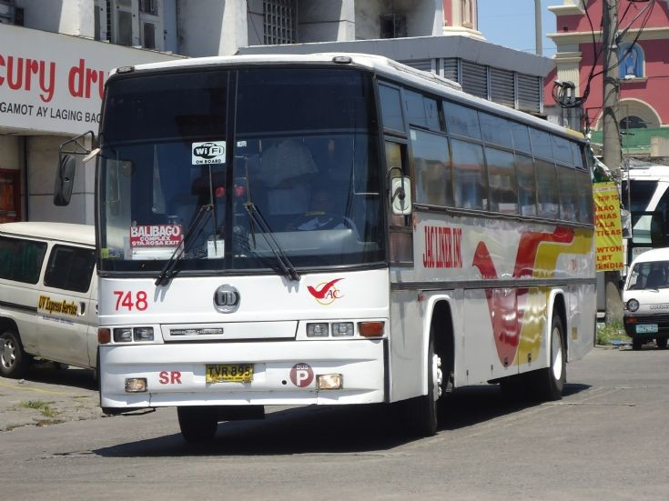
Bus number
Unique
Used for
Law enforcement
Traffic management

Slide 4
Data set

Slide 5
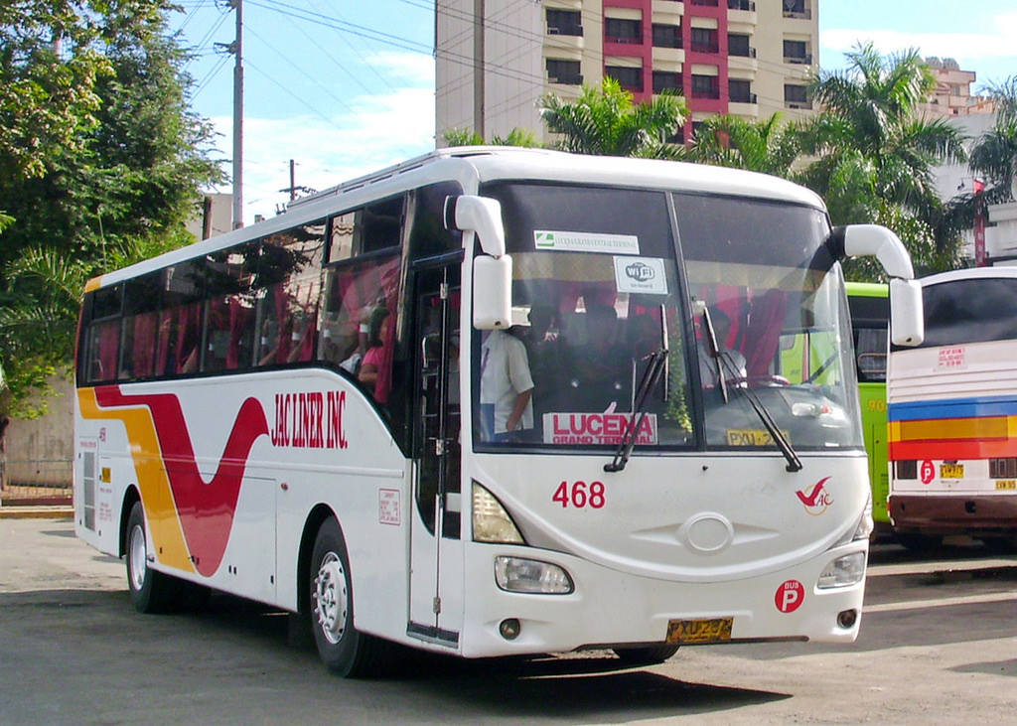
Data set
15 Jag liner buses
The bus is at the centre
Well illuminated
The bus number is visible

Slide 6
Methodology

Slide 7
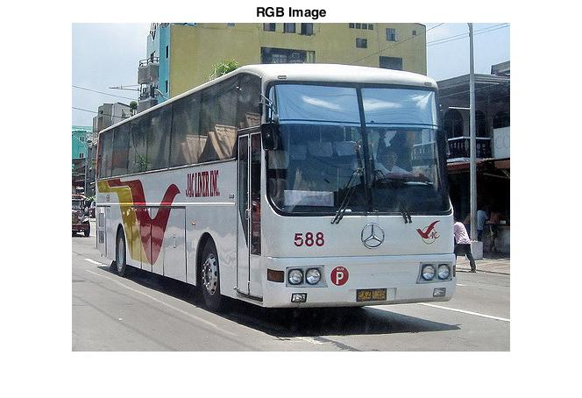
One
RGB

Slide 8
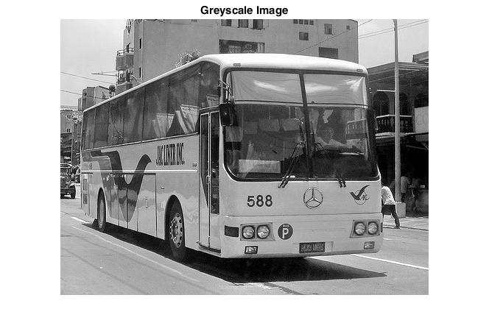
TWO
Greyscale
0.2989*R + 0.587*G + 0.114*B

Slide 9
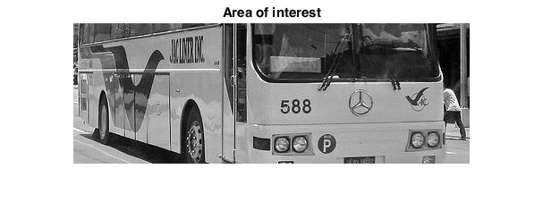
THREE
Area of interest
Get borders of the bus
Remove the top half

Slide 10

Four
Filled edges
Get edges via vertical Sobel operator
Dilates the edges

Slide 11
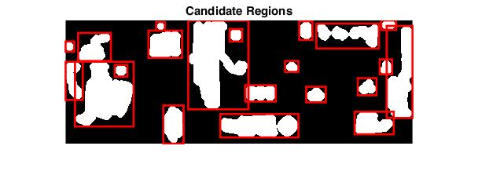
Five
Candidate Regions
Fill the edges

Slide 12
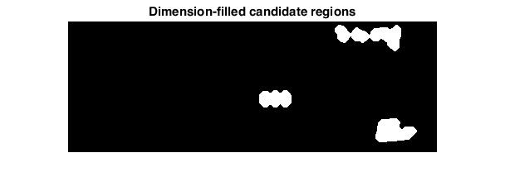
Six
Dimension-filled candidate regions
Valid regions: W/H = [1.5, 2.5]

Slide 13
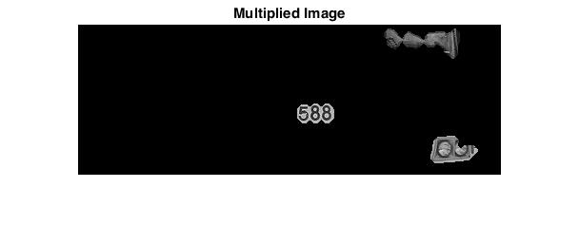
Seven
Multiplied image
Multiply the previous image with the greyscale image

Slide 14
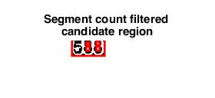
Eight
Segment count filtered candidate region
Valid regions have a segment count of [3, 9]

Slide 15
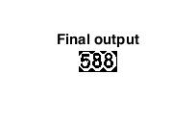
Nine
Final output

Slide 16
Results

Slide 17
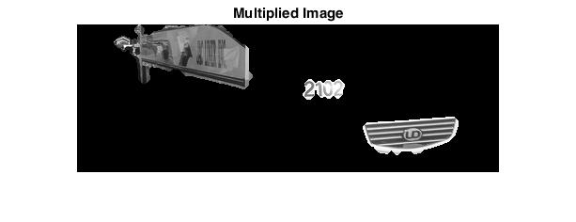

Results
3 out of 15 were correctly identified
20%

Slide 18
Conclusion and recommendations

Slide 19
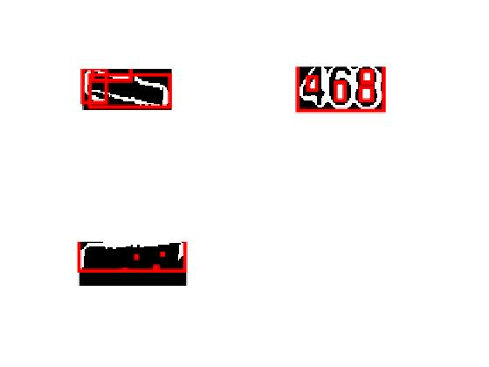
Conclusions
The low accuracy is caused by
The bus number being removed in pre processing
Areas in the bus like, its placard being tagged instead
Multiple end results

Slide 20
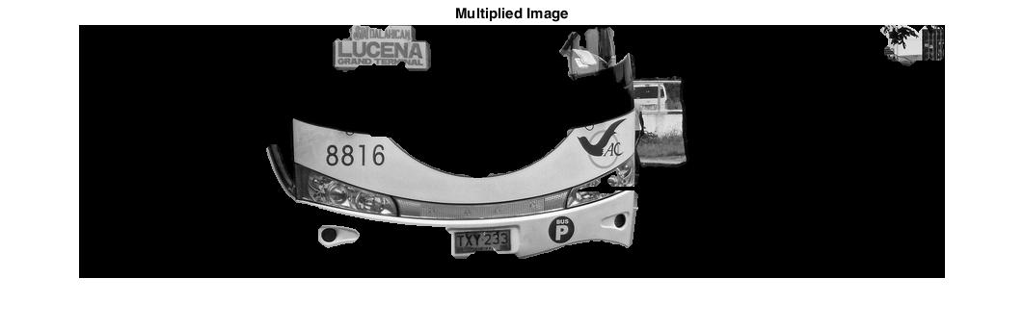

Recommendations
A larger sample size
Have the images be taken from the same angle
Make a way of removing text-filled areas such as the bus name and placard.

